Slide 1
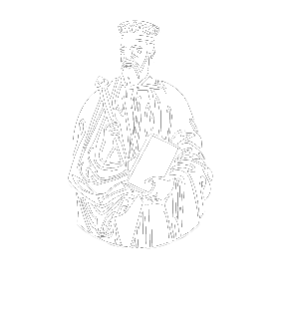
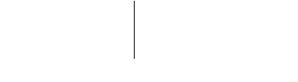
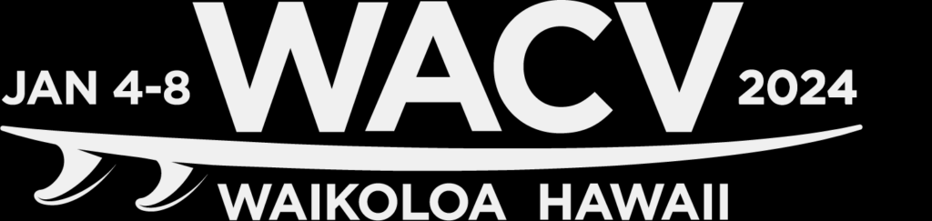

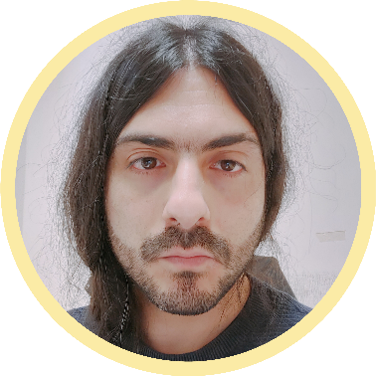

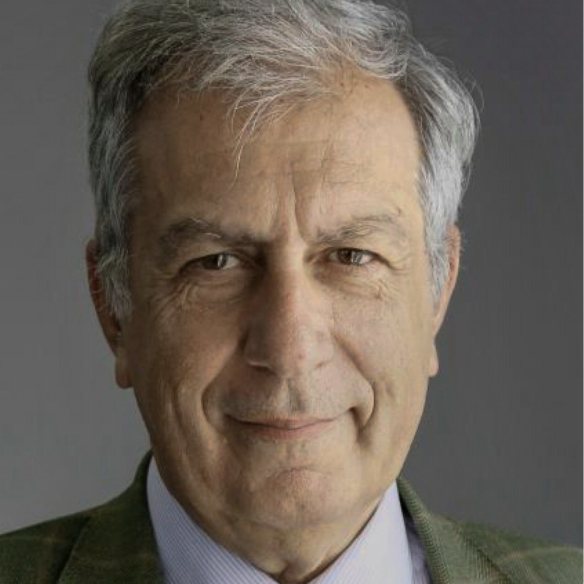
ARNIQA: Learning Distortion Manifold for Image Quality Assessment
Lorenzo Agnolucci¹
Leonardo Galteri²
Marco Bertini¹
Alberto Del Bimbo¹
¹MICC – University of Florence
²Pegaso Telematic University
Winter Conference on Applications of Computer Vision 2024 (WACV2024)

Slide 2
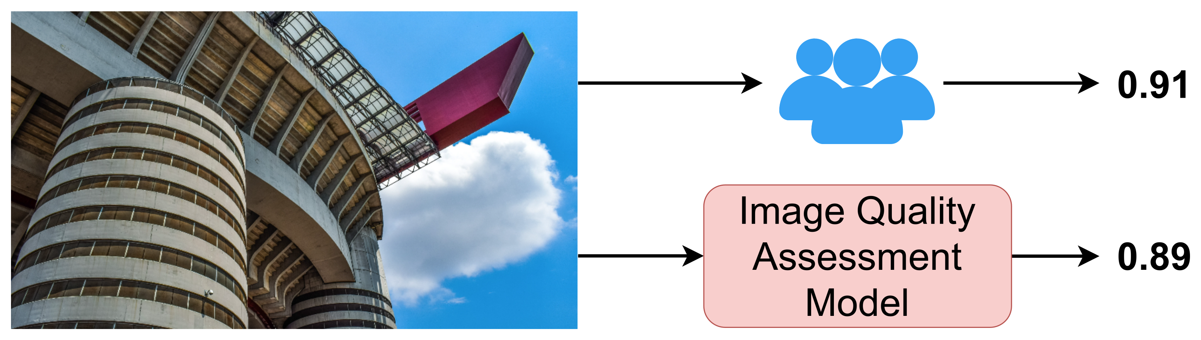
No-Reference IQA (NR-IQA)
🔍 No-Reference Image Quality Assessment (NR-IQA) focuses on designing methods to measure image quality in alignment with human perception when a high-quality reference image is unavailable

Slide 3
Motivations and Contributions
❌ Supervised methods for NR-IQA require labeled datasets, which are expensive and time-consuming to obtain
💡 Contributions
We propose ARNIQA, a self-supervised approach for NR-IQA that aims to learn the image distortion manifold by maximizing the similarity between the embeddings of different images degraded equally
We introduce an image degradation model that randomly assembles ordered sequences of distortions
Notes:
Supervised methods for No-Reference Image Quality Assessment require labeled datasets for training, which are expensive and time-consuming to obtain. This reliance on labeled data hampers the scalability and applicability of supervised approaches. To address this limitation we rely on self-supervised learning, and in particular we propose ARNIQA, a self-supervised approach for NR-IQA that aims to learn the image distortion manifold. To this end, we train an encoder by maximizing the similarity between the embeddings of different images degraded in the same way. In order to synthetically degrade the images during training, we introduce a custom image degradation model that randomly assembles ordered sequences of distortions. In this way, we expose our model to a wide variety of degradation patterns during training.

Slide 4
Self-Supervised Learning for NR-IQA
Self-supervised methods [1, 2] for NR-IQA involve 2 steps:
[1] Madhusudana et al., “Image Quality Assessment Using Contrastive Learning”, TIP 2022
[2] Saha et al., “Re-IQA: Unsupervised Learning for Image Quality Assessment in the Wild”, CVPR 2023
Notes:
Here we provide an overview on how self-supervised learning is applied to Image Quality Assessment. Self-supervised methods for No-Reference Image Quality Assessment involve 2 steps. The first step is the pre-training of an encoder using unlabeled images that are synthetically degraded with an image degradation model. The second step is the dataset-specific training of a linear regressor using the mean opinion scores. The linear regressor takes in input the image representations generated by the encoder and outputs the final quality scores. Note that in this second step, the encoder weights are frozen.

Slide 5
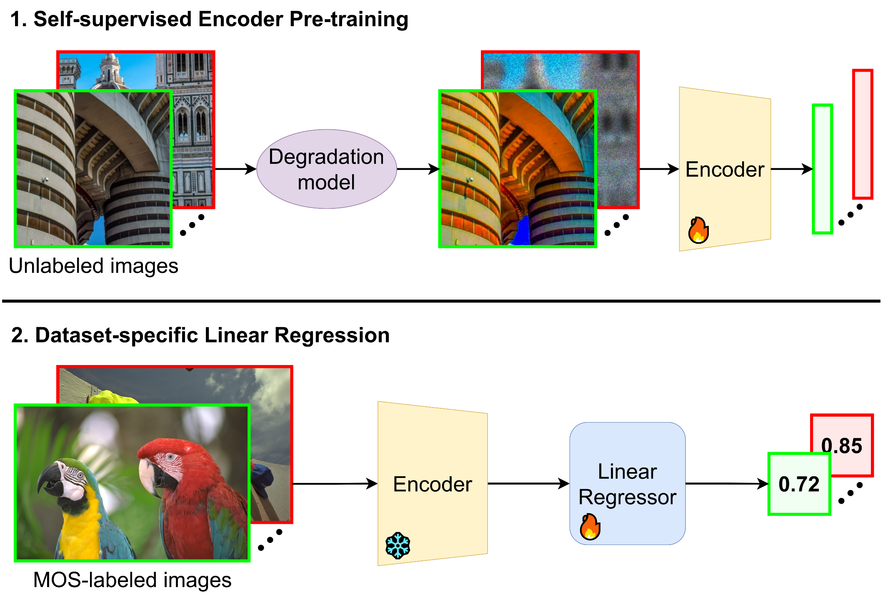
Self-Supervised Learning for NR-IQA
Self-supervised methods [1, 2] for NR-IQA involve 2 steps:
Step 1: Encoder pre-training using synthetically degraded unlabeled images
[1] Madhusudana et al., “Image Quality Assessment Using Contrastive Learning”, TIP 2022
[2] Saha et al., “Re-IQA: Unsupervised Learning for Image Quality Assessment in the Wild”, CVPR 2023
Notes:
Here we provide an overview on how self-supervised learning is applied to Image Quality Assessment. Self-supervised methods for No-Reference Image Quality Assessment involve 2 steps. The first step is the pre-training of an encoder using unlabeled images that are synthetically degraded with an image degradation model. The second step is the dataset-specific training of a linear regressor using the mean opinion scores. The linear regressor takes in input the image representations generated by the encoder and outputs the final quality scores. Note that in this second step, the encoder weights are frozen.

Slide 6
Self-Supervised Learning for NR-IQA
Self-supervised methods [1, 2] for NR-IQA involve 2 steps:
Step 1: Encoder pre-training using synthetically degraded unlabeled images
Step 2: Dataset-specific linear regressor training using the MOS
[1] Madhusudana et al., “Image Quality Assessment Using Contrastive Learning”, TIP 2022
[2] Saha et al., “Re-IQA: Unsupervised Learning for Image Quality Assessment in the Wild”, CVPR 2023
Notes:
Here we provide an overview on how self-supervised learning is applied to Image Quality Assessment. Self-supervised methods for No-Reference Image Quality Assessment involve 2 steps. The first step is the pre-training of an encoder using unlabeled images that are synthetically degraded with an image degradation model. The second step is the dataset-specific training of a linear regressor using the mean opinion scores. The linear regressor takes in input the image representations generated by the encoder and outputs the final quality scores. Note that in this second step, the encoder weights are frozen.

Slide 7
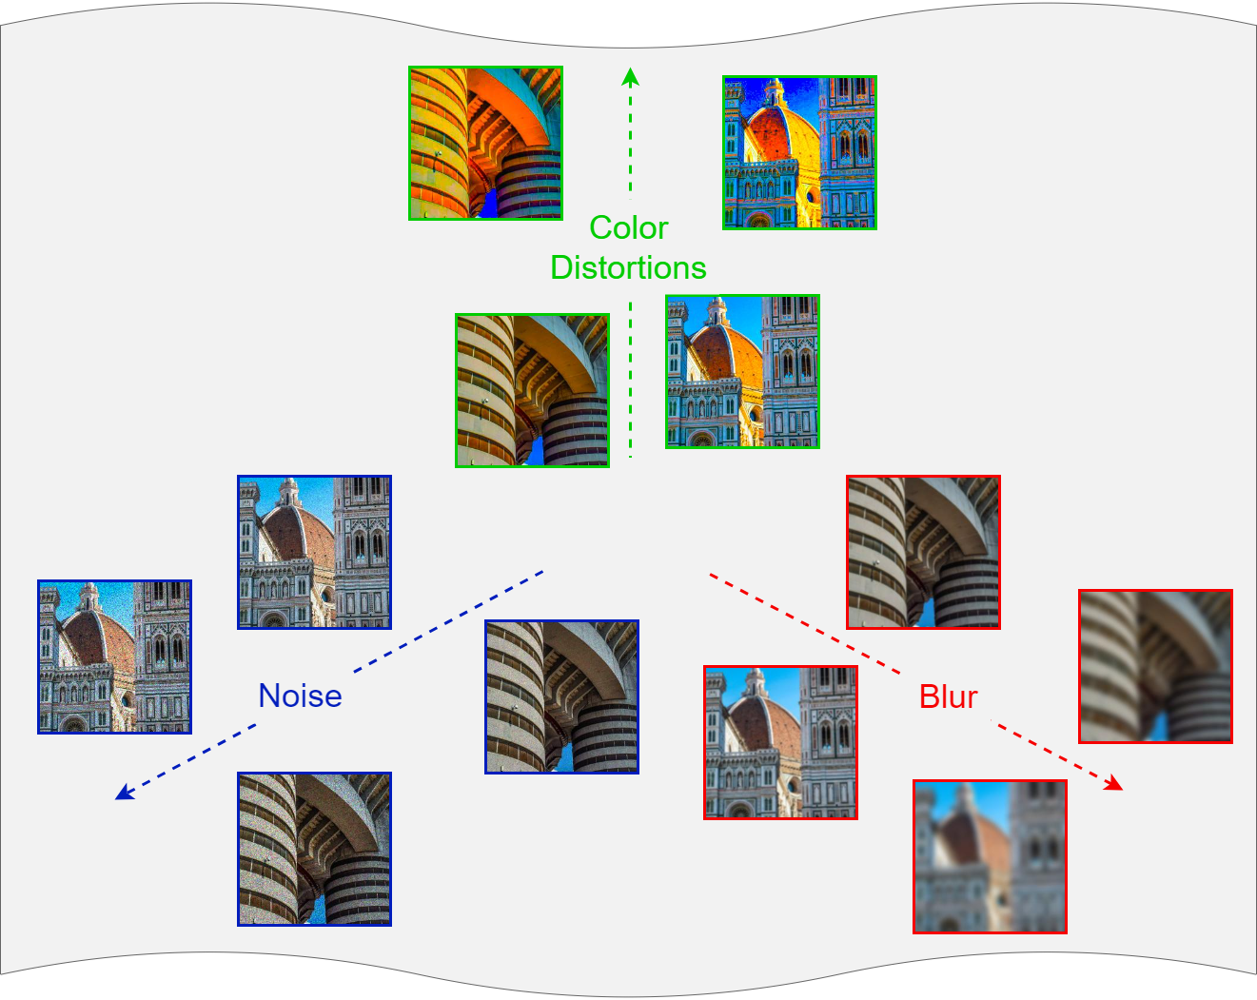
Image Distortion Manifold
The image distortion manifold [3] is the continuous space of all the possible degradations to which an image can be subjected
Different regions along this manifold represent various types and degrees of degradation
The image distortion manifold represents image quality in an intrinsic manner [3]
[3] Su et al., “From Distortion Manifold to Perceptual Quality: a Data Efficient Blind Image Quality Assessment Approach”, Pattern Recognition 2023
Notes:
The goal of our approach is modeling the image distortion manifold. The image distortion manifold is defined as the continous space of all the possible degradations to which an image can be subjected. In this manifold, different regions represent various types and degrees of degradation. For example, as we can see in the figure on the right, images showing distinct blur and noise patterns lie in different areas of the manifold. The image distortion manifold represents image quality in an instrinsic manner, as images showing similar degradation patterns are prone to be perceived as having similar quality.

Slide 8
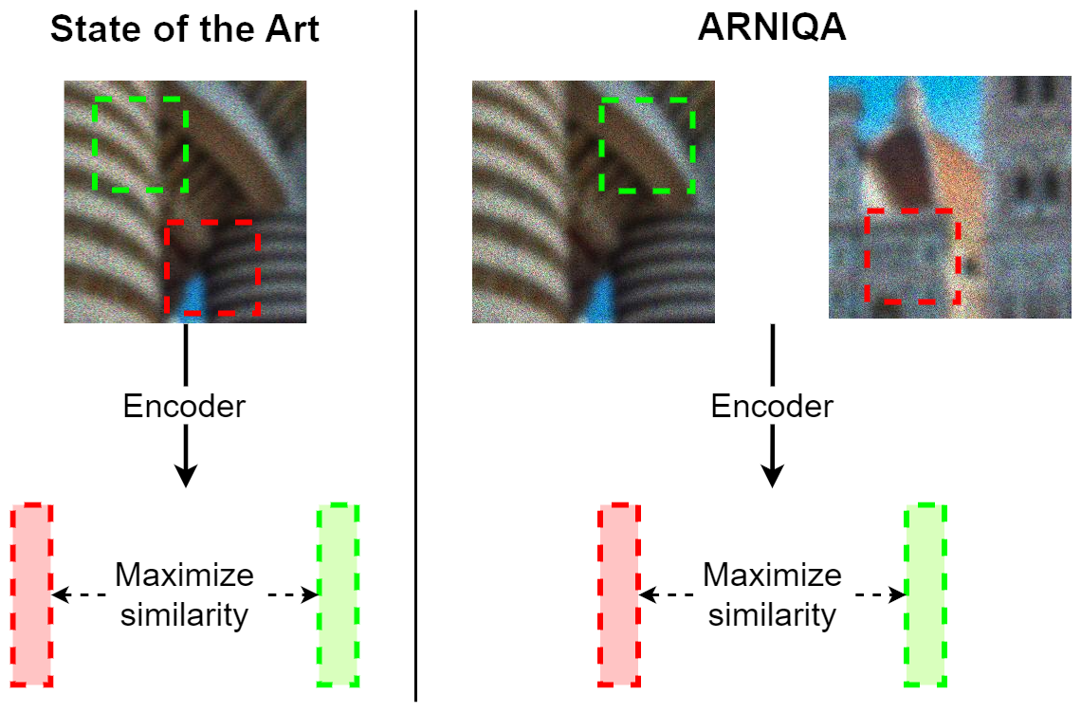
Idea
Maximize the similarity between the embeddings of two patches with:
State of the Art: similar content / same distortion
ARNIQA: different content / same distortion
Notes:
Here we show the main idea of our work and the difference between ARNIQA and other self-supervised methods for No-Reference Image Quality Assessment. The current state of the art is based on maximizing the similarity between two patches from the same image. Therefore, the patches share similar content and are degraded in the same way. On the contrary, we maximize the similarity between the representations of two patches coming from two different images degraded in the same manner. Therefore, the patches contain completely different content but are degraded with the same distortion. In this way, we make our encoder generate similar embeddings for different images degraded in the same way, despite varying content.

Slide 9
Idea
Maximize the similarity between the embeddings of two patches with:
State of the Art: similar content / same distortion
ARNIQA: different content / same distortion
Notes:
Here we show the main idea of our work and the difference between ARNIQA and other self-supervised methods for No-Reference Image Quality Assessment. The current state of the art is based on maximizing the similarity between two patches from the same image. Therefore, the patches share similar content and are degraded in the same way. On the contrary, we maximize the similarity between the representations of two patches coming from two different images degraded in the same manner. Therefore, the patches contain completely different content but are degraded with the same distortion. In this way, we make our encoder generate similar embeddings for different images degraded in the same way, despite varying content.

Slide 10
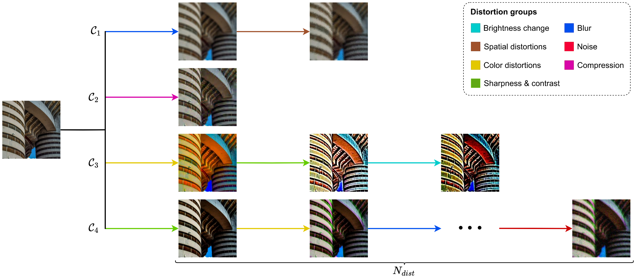
Image Degradation Model
We randomly assemble ordered sequences of distortions
Our image degradation model can generate 100 times more distinct distortion compositions than existing methods [4]
[4] Zhao et al., “Quality-aware Pre-trained Models for Blind Image Quality Assessment”, CVPR 2023
Notes:
To effectively learn the image distortion manifold we need to expose our model to a wide variety of different degradation patterns. For this reason, we introduce an image degradation model that randomly assembles ordered sequences of distortions. Given a distortion, we can apply it to a pristine image to obtain its degraded version. We consider 24 different degradation types divided into 7 groups. For each composition, we sample the number of total distortions . Then, we sample an equal number of distortion groups. Finally, we sample the specific types and the degree of distortion of the degradations within the chosen groups. With this strategy, our image degradation model is able to generate about 100 times more distinct distortion compositions than existing methods, thus exposing our model to more diverse degradation patterns during training.

Slide 11
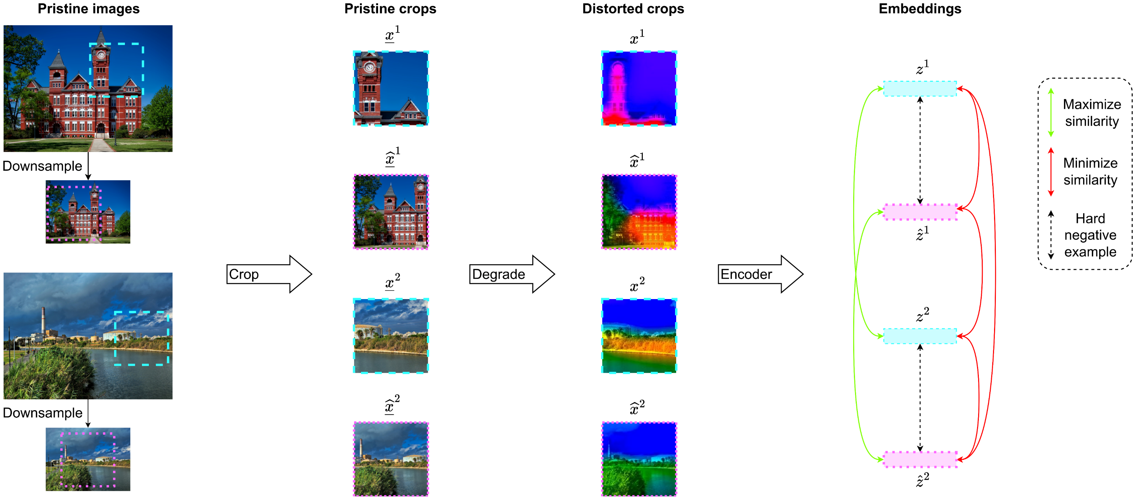
Training Strategy
We treat half-resolution crops as hard negative examples, as they differ from the full-scale ones only for a downsampling distortion
Notes:
Here we provide more details on our training approach, which is based on SimCLR and the InfoNCE contrastive loss. To improve the performance of contrastive learning, we propose a strategy to guarantee the presence of hard negative examples within each batch by considering half-scale images. Starting from two pristine images, we downsample them to obtain their half-scale versions. Then we extract one random crop from each image. After this, we employ the proposed image degradation model to degrade the four crops using the same distortions composition. Finally, we encode the degraded crops using the encoder. We use a contrastive loss to maximize the similarity between the embeddings of the pairs of full-scale and half-scale crops. At the same time, we minimize the similarity between all the other examples. Here, half-scale crops represent hard negative examples as they differ from the full-scale ones only for a downsampling distortion. Indeed, note how even if the clock tower is visible in both the full-scale and half-scale versions of the pristine image, after the degradation it becomes a red blob in the full scale image while in the half scale version it is completely blue, due to the downsampling distortion.

Slide 12
Training Strategy
We treat half-resolution crops as hard negative examples, as they differ from the full-scale ones only for a downsampling distortion
Notes:
Here we provide more details on our training approach, which is based on SimCLR and the InfoNCE contrastive loss. To improve the performance of contrastive learning, we propose a strategy to guarantee the presence of hard negative examples within each batch by considering half-scale images. Starting from two pristine images, we downsample them to obtain their half-scale versions. Then we extract one random crop from each image. After this, we employ the proposed image degradation model to degrade the four crops using the same distortions composition. Finally, we encode the degraded crops using the encoder. We use a contrastive loss to maximize the similarity between the embeddings of the pairs of full-scale and half-scale crops. At the same time, we minimize the similarity between all the other examples. Here, half-scale crops represent hard negative examples as they differ from the full-scale ones only for a downsampling distortion. Indeed, note how even if the clock tower is visible in both the full-scale and half-scale versions of the pristine image, after the degradation it becomes a red blob in the full scale image while in the half scale version it is completely blue, due to the downsampling distortion.

Slide 13
Training Strategy
We treat half-resolution crops as hard negative examples, as they differ from the full-scale ones only for a downsampling distortion
Notes:
Here we provide more details on our training approach, which is based on SimCLR and the InfoNCE contrastive loss. To improve the performance of contrastive learning, we propose a strategy to guarantee the presence of hard negative examples within each batch by considering half-scale images. Starting from two pristine images, we downsample them to obtain their half-scale versions. Then we extract one random crop from each image. After this, we employ the proposed image degradation model to degrade the four crops using the same distortions composition. Finally, we encode the degraded crops using the encoder. We use a contrastive loss to maximize the similarity between the embeddings of the pairs of full-scale and half-scale crops. At the same time, we minimize the similarity between all the other examples. Here, half-scale crops represent hard negative examples as they differ from the full-scale ones only for a downsampling distortion. Indeed, note how even if the clock tower is visible in both the full-scale and half-scale versions of the pristine image, after the degradation it becomes a red blob in the full scale image while in the half scale version it is completely blue, due to the downsampling distortion.

Slide 14
Training Strategy
We treat half-resolution crops as hard negative examples, as they differ from the full-scale ones only for a downsampling distortion
Notes:
Here we provide more details on our training approach, which is based on SimCLR and the InfoNCE contrastive loss. To improve the performance of contrastive learning, we propose a strategy to guarantee the presence of hard negative examples within each batch by considering half-scale images. Starting from two pristine images, we downsample them to obtain their half-scale versions. Then we extract one random crop from each image. After this, we employ the proposed image degradation model to degrade the four crops using the same distortions composition. Finally, we encode the degraded crops using the encoder. We use a contrastive loss to maximize the similarity between the embeddings of the pairs of full-scale and half-scale crops. At the same time, we minimize the similarity between all the other examples. Here, half-scale crops represent hard negative examples as they differ from the full-scale ones only for a downsampling distortion. Indeed, note how even if the clock tower is visible in both the full-scale and half-scale versions of the pristine image, after the degradation it becomes a red blob in the full scale image while in the half scale version it is completely blue, due to the downsampling distortion.

Slide 15
Training Strategy
We treat half-resolution crops as hard negative examples, as they differ from the full-scale ones only for a downsampling distortion
Notes:
Here we provide more details on our training approach, which is based on SimCLR and the InfoNCE contrastive loss. To improve the performance of contrastive learning, we propose a strategy to guarantee the presence of hard negative examples within each batch by considering half-scale images. Starting from two pristine images, we downsample them to obtain their half-scale versions. Then we extract one random crop from each image. After this, we employ the proposed image degradation model to degrade the four crops using the same distortions composition. Finally, we encode the degraded crops using the encoder. We use a contrastive loss to maximize the similarity between the embeddings of the pairs of full-scale and half-scale crops. At the same time, we minimize the similarity between all the other examples. Here, half-scale crops represent hard negative examples as they differ from the full-scale ones only for a downsampling distortion. Indeed, note how even if the clock tower is visible in both the full-scale and half-scale versions of the pristine image, after the degradation it becomes a red blob in the full scale image while in the half scale version it is completely blue, due to the downsampling distortion.

Slide 16
Training Strategy
We treat half-resolution crops as hard negative examples, as they differ from the full-scale ones only for a downsampling distortion
Notes:
Here we provide more details on our training approach, which is based on SimCLR and the InfoNCE contrastive loss. To improve the performance of contrastive learning, we propose a strategy to guarantee the presence of hard negative examples within each batch by considering half-scale images. Starting from two pristine images, we downsample them to obtain their half-scale versions. Then we extract one random crop from each image. After this, we employ the proposed image degradation model to degrade the four crops using the same distortions composition. Finally, we encode the degraded crops using the encoder. We use a contrastive loss to maximize the similarity between the embeddings of the pairs of full-scale and half-scale crops. At the same time, we minimize the similarity between all the other examples. Here, half-scale crops represent hard negative examples as they differ from the full-scale ones only for a downsampling distortion. Indeed, note how even if the clock tower is visible in both the full-scale and half-scale versions of the pristine image, after the degradation it becomes a red blob in the full scale image while in the half scale version it is completely blue, due to the downsampling distortion.

Slide 17
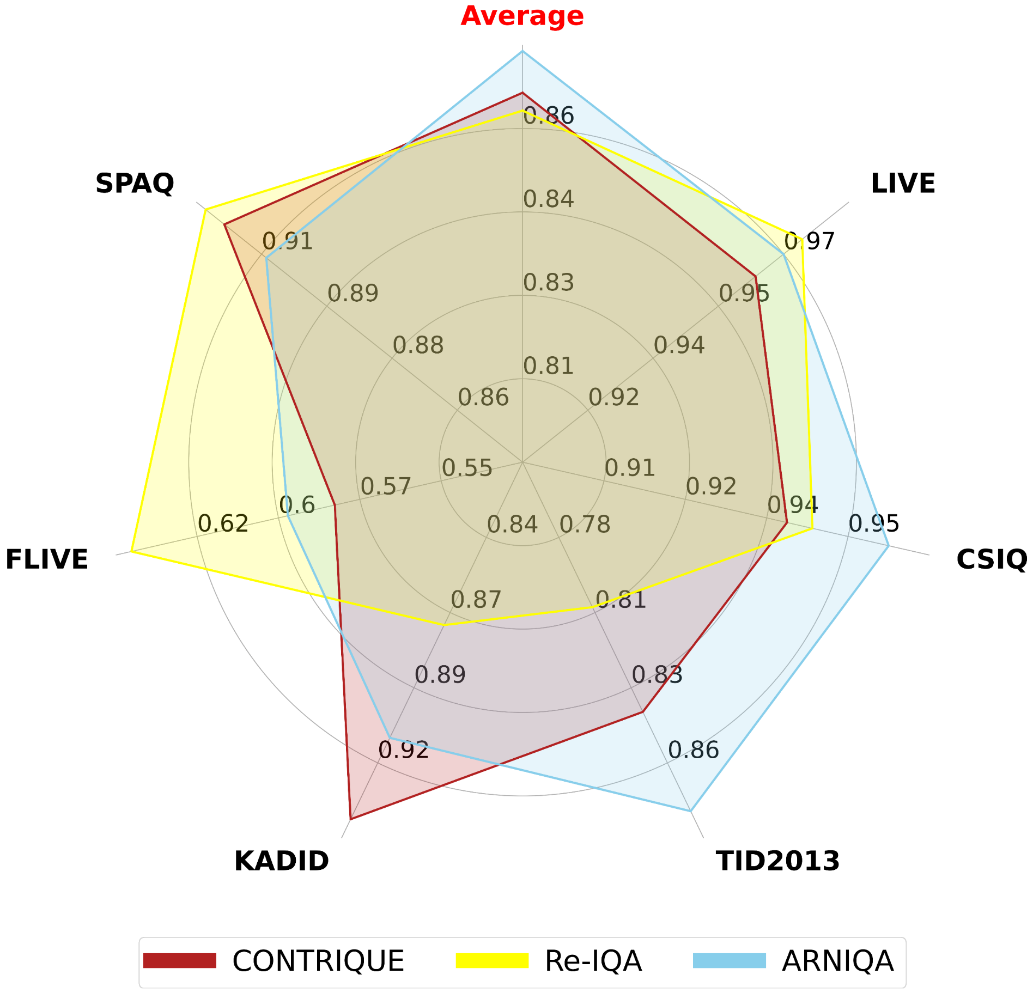
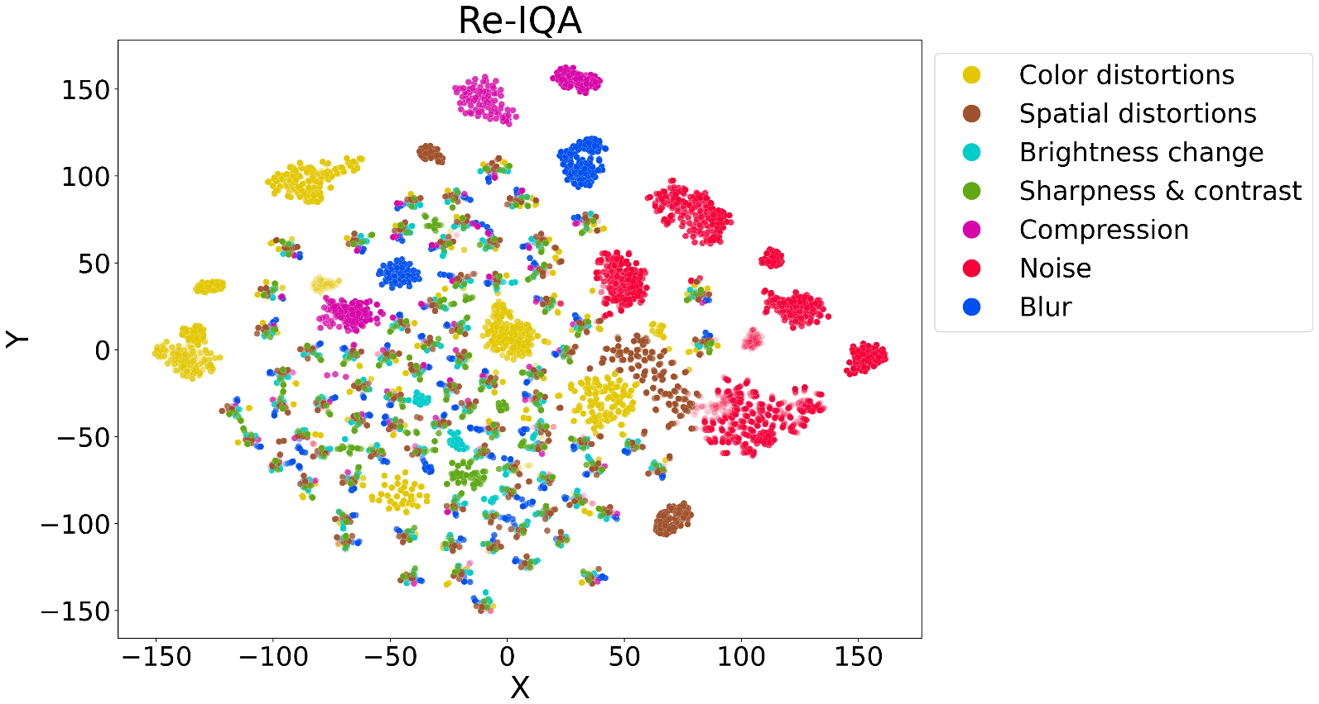
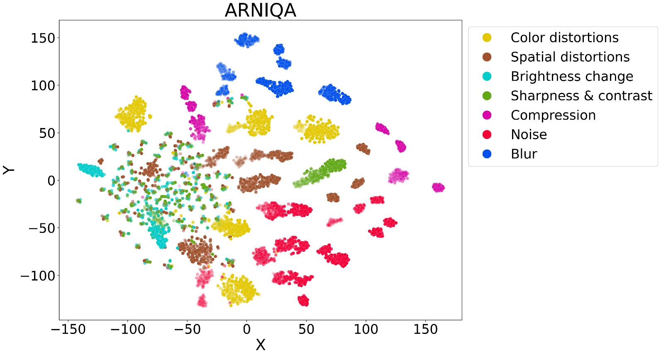
Results
Notes:
Let’s take a look at the experimental results. We compare ARNIQA to state-of-the-art methods on six different Image Quality Assessment datasets, comprising both synthetic and authentic distortions. On the left, we can see that ARNIQA achieves state-of-the-art results on all the datasets and obtains the best performance on average. On the right, we compare the t-SNE visualizations of the embeddings of the KADID dataset of Re-IQA and ARNIQA. The plots show that ARNIQA generates more easily distinguishable clusters for different degradation types. This is consistent with our training strategy, which aims to train an encoder that generates similar embeddings for images degraded in the same way.

Slide 18
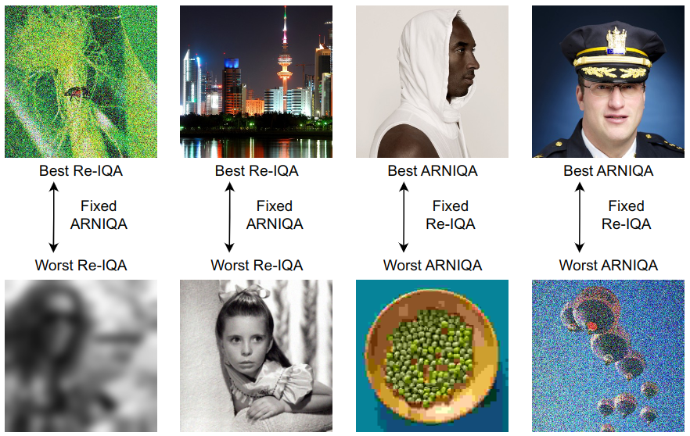
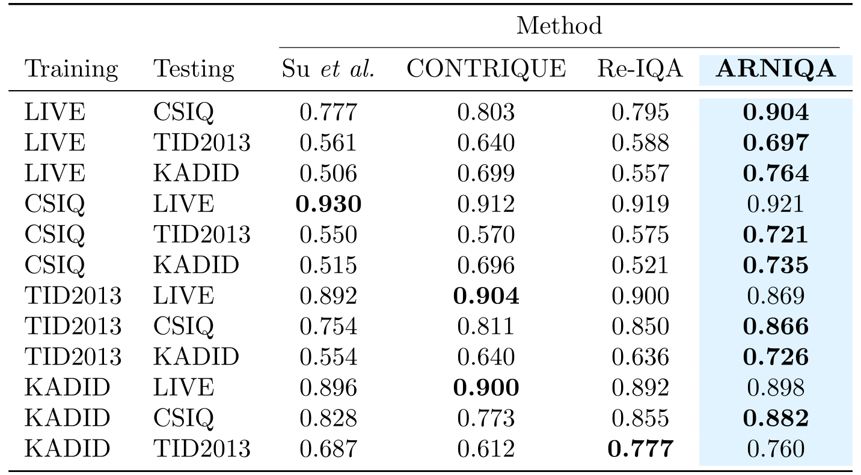
Results
ARNIQA demonstrates better robustness and generalization capabilities compared to competing methods
[5] Ma et al., “Group MAD Competition - A New methodology to Compare Objective Image Quality Models”, CVPR 2016
Notes:
Furthermore, we evaluated the robustness and generalization capabilities of our method. On the left, we report the results of the group maximum differentiation competition between Re-IQA and ARNIQA. The results show that our method is more robust. On the right, we provide the results of the cross-dataset evaluation. Also in this case, ARNIQA outperforms the baselines, proving to have better generalization capabilities.

Slide 19
Conclusions
❌ Supervised methods are limited by their reliance on expensive manual data labeling
💡 ARNIQA models the image distortion manifold in a self-supervised manner by maximizing the similarity between the representations of different images degraded in the same way
📈 ARNIQA achieves SotA results with improved generalization capabilities and robustness w.r.t. competing methods
Thanks for listening!
Lorenzo Agnolucci
Leonardo Galteri
Marco Bertini
Alberto Del Bimbo
[name].[surname]@unifi.it
MICC – University of Florence, Italy
Notes:
In conclusion, we have seen that supervised methods for NR-IQA are limited by their reliance on expensive manual data labeling. To address this limitation, we propose an approach named ARNIQA that models the image distortion manifold in a self-supervised way by maximizing the similarity betw

